Slide 1

Fail Well
How to Fail & Recover Like a Pro
with i@joshsimmons.com
@joshsimmons | philosophy, psychology, technology
co-founder @beawimp | community manager, programming @oreillymedia
Notes:
I’m a community organizer and web developer, currently working on open source and web tech for O’Reilly Media.
I’ve failed a LOT and in more ways than you can imagine in my career, as a freelancer, as a startup CEO, and as an employee.
My goal is to help you fail well – like gymnasts who learn how to fall so they don’t injure themselves.

Slide 2

"If you're going to fail, please fail loudly and sing it as if your life depended on it.” - Lee Yopp
Notes:
We’re all fans of open source here, so I don’t think I need to convince you of the value of sharing. Sharing about failure is hard, but it’s important.
My goal with this talk is to help you (1) learn about types of failure so you can see them coming, or at least do a better post mortem, (2) learn how to recover from failure, because failure is hard, and (3) get more comfortable talking about failure.
OK, so a brief outline before we dive in: We’ll start with 10 types of failure, my top ten things NOT to do, followed by a discussion of how to recover – because we all know failures large and small are inevitable.
Two notes: Sometimes I talk too fast – if I’m going too fast, raise your hand and I’ll slow down :-) Please hold questions till the end – I’ll be happy to chat in the hallway if we run out of time.
Ready?

Slide 3
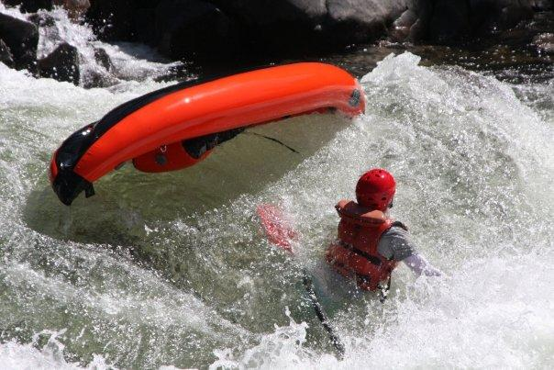
Hello, world!
Notes:
This is me getting myself in over my head, a total newb taking on a level 4 white water rapid in an inflatable kayak.
White water rafting is dangerous. It’s VERY likely you will fall into the river sooner or later, but there are things you can do to, well, avoid dying.
First, get out from under the boat and away from other rafters! You don’t want to get trapped or slam into each other.
In order to keep from drowning
Look out for “strainers,” which are bushes and dead trees that you can snare you. If you get snared, climb OVER it.
And don’t flip vertically, spin horizontally, otherwise your feet may get caught in the rocks on the river bed.
In order to avoid bone breakage
Go legs first, not head first! That’s self explanatory.
Keep your legs up, so your butt absorbs the impacts from boulders – not your spine.
And take a BIG breath whenever you can!
You don’t know when your next breath will be.
So what? The point of this illustration is to illustrate that falling out of the raft, or failure, doesn’t usually kill people – and there are things we can do to improve our odds… and though I don’t think the analogy stretches this far, failure can make us even stronger.
These lessons are drawn from my experience, so the stories I tell will be in context of freelancing, agency work, and startups. But these are universal lessons...
And lastly to be clear, I did not fail well. I failed badly. Please, do better than I did!

Slide 4

How to Fail
Notes:
How to Fail
fail to measure
work without a contract
overcommit
give it away for free
surprise a client
do everything
be an island
work yourself out of a job
put all your eggs in one basket
lose touch with your clients

Slide 5

10. Lose Touch with People
10. Lose Touch with Your Clients
Notes:
10. Lose Touch with People
Stay top of mind with your clients, coworkers, and your communities – both past and present.
Most jobs are NOT advertised, so your network is your #1 resource for finding work (and staying sharp). And, in context of contract work, the shortest path to money is through the clients you already have.
Attend events
Send relevant news
Holidays
Newsletter?
Blog!
Maintenance contracts

Slide 6

9. Put All Your Eggs in One Basket
10. Lose Touch with Your Clients
9. Put All Your Eggs in One Basket
Notes:
9. Put All Your Eggs in One Basket
Use multiple marketing channels
Diversify your skills and know how to pitch yourself several different ways
Have many clients, you should be able to lose a client or two without falling into a financial tailspin
Or, have ins at many different companies

Slide 7
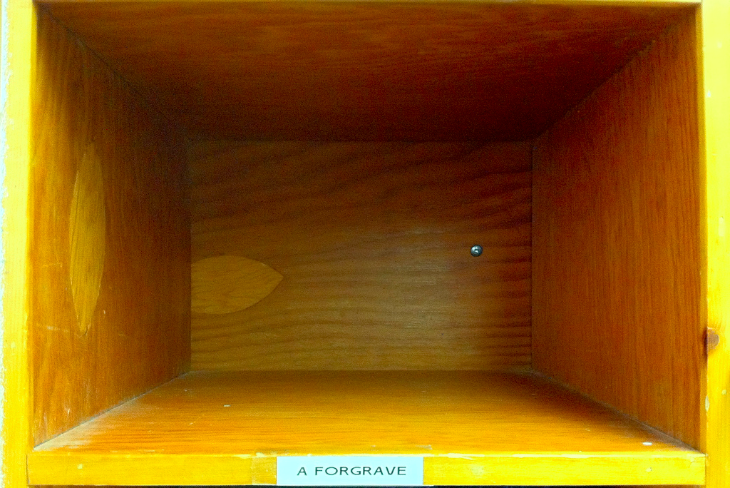
8. Work Yourself Out of a Job
10. Lose Touch with Your Clients
9. Put All Your Eggs in One Basket
8. Work Yourself Out of a Job
Notes:
8. Work Yourself Out of a Job
As a freelancer, you are ALWAYS looking for work to fill your project pipeline, otherwise you’ll finish a project and go pale with horror as you realize you don’t know where the next check is coming from. If you’re familiar with the concept of a sales funnel and sales cycles, well, study up!
As an employee, it’s tempting to become “indispensable” so you have job security. But the reality is that you MUST be dispensable in order to get a promotion. For employees, working yourself out of a job mostly means staying sharp.

Slide 8
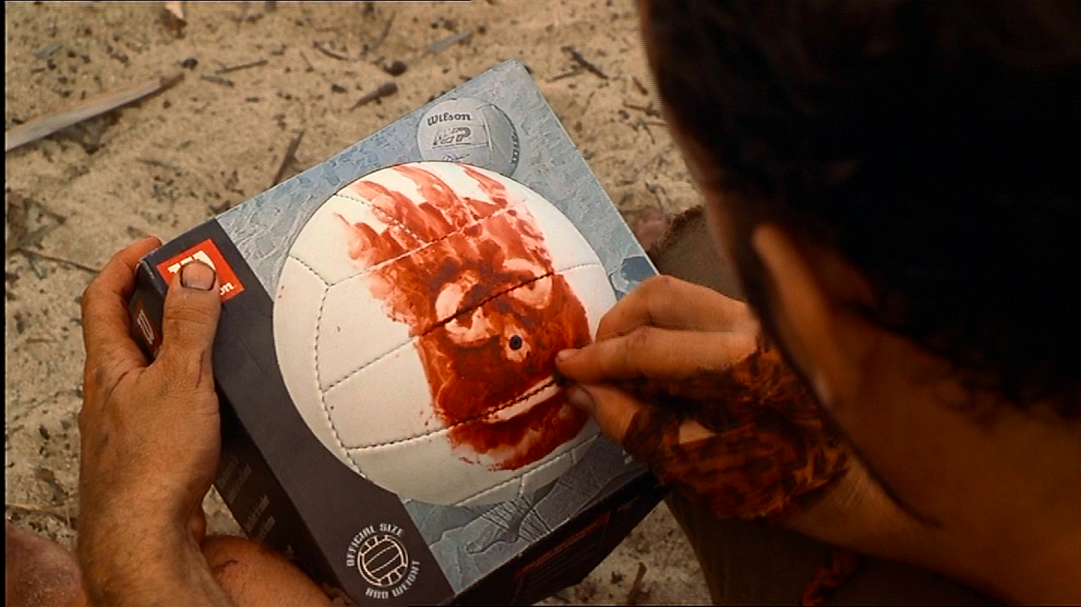
7. Be an Island
10. Lose Touch with Your Clients
9. Put All Your Eggs in One Basket
8. Work Yourself Out of a Job
7. Be an Island
Notes:
7. Be an Island
Participate in communities online and off (you’re here so you’re already doing great)
This is the best way to find work and stay sharp.
Harking back to “Don’t Put All Your Eggs in One Basket,” consider joining multiple communities... Don’t limit yourself to the Python watering hole, join the larger engineering community.

Slide 9

6. Do Everything
10. Lose Touch with Your Clients
9. Put All Your Eggs in One Basket
8. Work Yourself Out of a Job
7. Be an Island
6. Do Everything
Notes:
6. Do Everything
niche
virtual asst
biz model
ad hoc team
join + start a community

Slide 10

5. Surprise People
10. Lose Touch with Your Clients
9. Put All Your Eggs in One Basket
8. Work Yourself Out of a Job
7. Be an Island
6. Do Everything
5. Surprise a Client
Notes:
5. Surprise People
phase or agile
expectations!
good/delight
scope creep - amend or defer

Slide 11

4. Give It Away for Free
10. Lose Touch with Your Clients
9. Put All Your Eggs in One Basket
8. Work Yourself Out of a Job
7. Be an Island
6. Do Everything
5. Surprise a Client
4. Give It Away for Free
Notes:
4. Give It Away for Free
always list full rate
ask for referral, testimonial
rec $200/hr starting!!!
barter

Slide 12

3. Over Commit
10. Lose Touch with Your Clients
9. Put All Your Eggs in One Basket
8. Work Yourself Out of a Job
7. Be an Island
6. Do Everything
5. Surprise a Client
4. Give It Away for Free
3. Over Commit
Notes:
3. Over Commit
say no
priorities
connect / delegate / subcontract

Slide 13
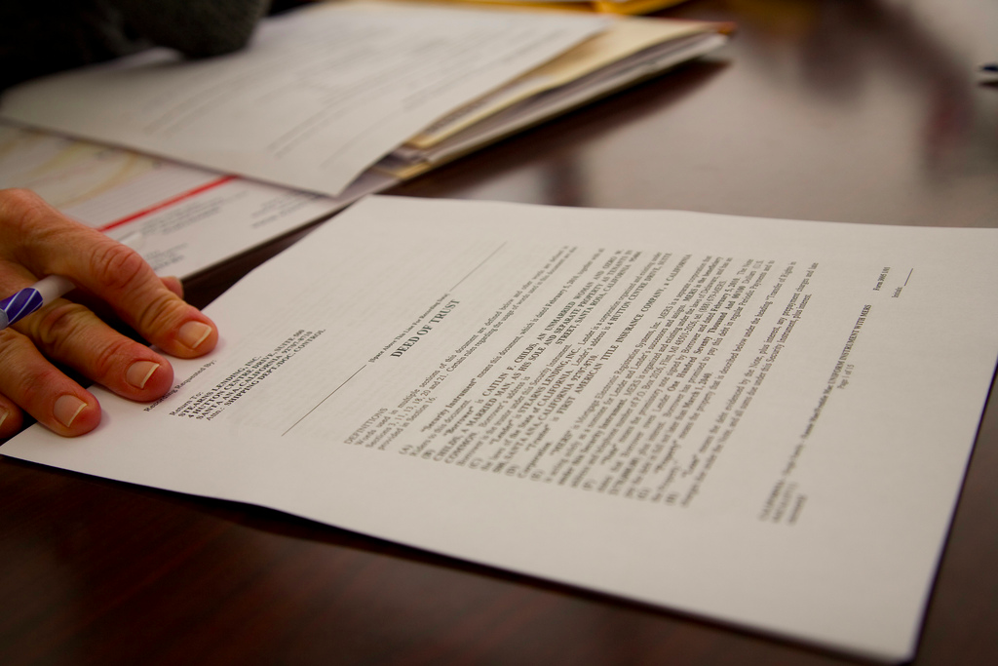
2. Work Without a Contract
10. Lose Touch with Your Clients
9. Put All Your Eggs in One Basket
8. Work Yourself Out of a Job
7. Be an Island
6. Do Everything
5. Surprise a Client
4. Give It Away for Free
3. Over Commit
2. Work Without a Contract
Notes:
2. Work Without a Contract
not punitive
short and sweet
even an invoice or emails count
key clauses
licensing
contact info & expectations
payment
warranty / SLA -- for apps and maintenance contract
arbitration (arbitration association plz!) - nobody wants to go to court. that sucks, trust me.
expiry (
friendly/plain English (ish)

Slide 14

1. Fail to Measure
10. Lose Touch with Your Clients
9. Put All Your Eggs in One Basket
8. Work Yourself Out of a Job
7. Be an Island
6. Do Everything
5. Surprise a Client
4. Give It Away for Free
3. Over Commit
2. Work Without a Contract
1. Fail to Measure
Notes:
1. Fail to Measure
budget
estimates
limits / capacity
growth / goals / profit

Slide 15

Fail Well
Notes:
FAIL WELL
really, it’s about grace under fire
saving the relationship
terminating the relationship
managing yourself
managing your reputation

Slide 16

Managing the Relationship

Slide 17

Saving the Relationship
Notes:
social capital
a good apology
thanks
amends?
continue? adjust? move on?

Slide 18

Terminating the Relationship
Notes:
legal process
make it amicable
verbalize why - narrative
? refer to someone else if the client isn’t a bad client

Slide 19

Managing Yourself
Notes:
it’s not the end
one step at a time
empower yourself - don’t let cleaning become a displace activity (procrastinate), but it can help you regain sense of control
don’t withdraw
don’t lash out
guilt/blame
#1 comm #2 prod
non-work identity

Slide 20
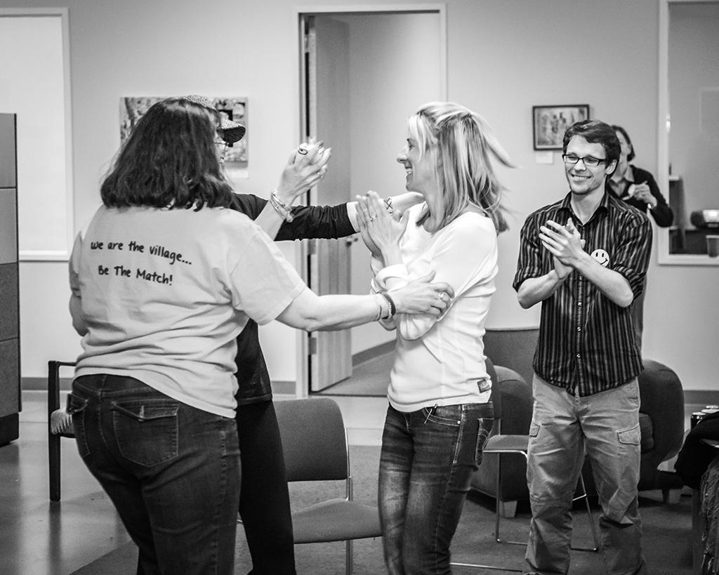
Manage Your Reputation
Notes:
don’t let it snowball
be honest, be vulnerable
actions speak louder than words
… but having a narrative helps
what do you stand for?
take the high road
no excuses, not even reasons - unless people ask
share your lessons

Slide 21

fail fast
fail often
fail well
slide deck and credits:
slideshare.net/joshsimmons/fail-well
@joshsimmons aka bluesomewhere
community strategist
open source web developer
Notes:
Thank you! Find me on Twitter and my slides on Slideshare… where I’ll be uploaded updated slides when I get to my hotel because the university wifi has Slideshare blocked ☺
With that, go out and fail well! (Questions?)

